Slide 1
THE IA
IA-1 - Overview

Slide 2
THE FIVE CRITERIA
The IA is split into 5 criteria
A – Problem specification – 4 Marks
B – Planning – 4 Marks
C – System Overview – 6 Marks
D – Development – 12 Marks
E – Evaluation – 4 Marks

Slide 3
CRITERIA A – PROBLEM SPECIFICATION
300 words
Success criteria listed here will be used all throughout the paper
Three main parts:
Problem Scenario
Success Criteria
Computational Context

Slide 4
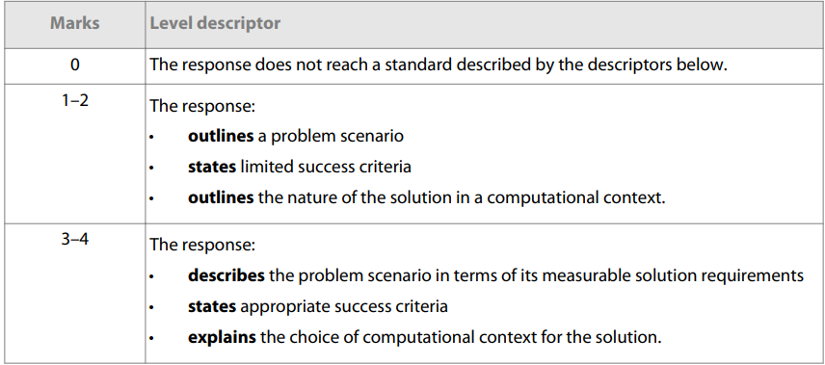
CRITERIA A – PROBLEM SPECIFICATION
300 words

Slide 5
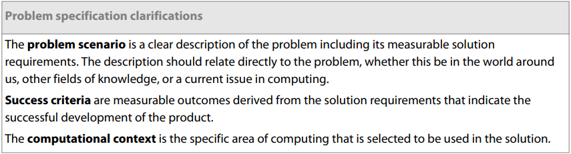
CRITERIA A – PROBLEM SPECIFICATION
300 words

Slide 6
CRITERIA B – PLANNING
150 words
Assessed on how the scenario is decomposed into parts
Plan should address requirements in terms of success criteria, must include a timeline of steps
Likely a GANTT or AGILE chart
Plan may include relevant research into libraries, tools, etc.

Slide 7
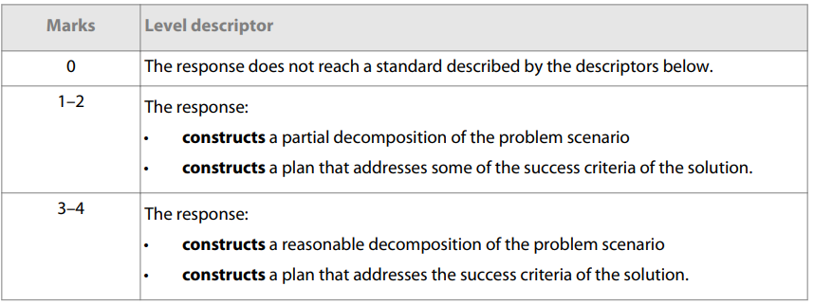
CRITERIA B – PLANNING
150 words

Slide 8
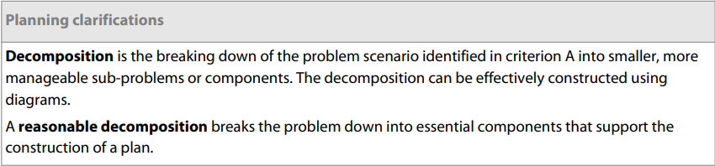
CRITERIA B – PLANNING
150 words

Slide 9
CRITERIA C – SYSTEM OVERVIEW
150 words
System model with key components and their relationships, rules governing interaction
Detail algorithms used
Detail user interface
Goal: a third party should be able to recreate your app by reading this criteria
Provide information for a viable testing strategy

Slide 10
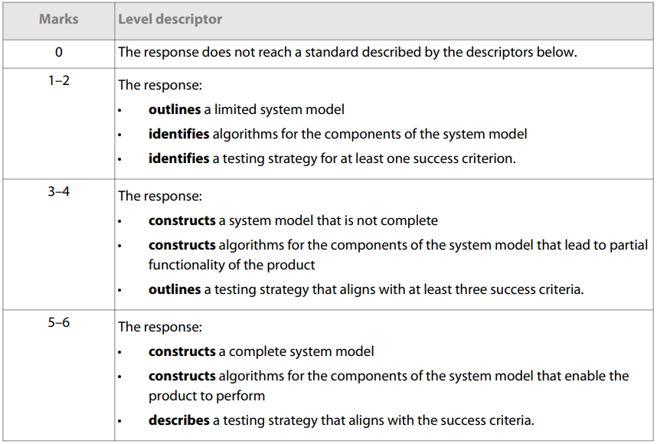
CRITERIA C – SYSTEM OVERVIEW
150 words

Slide 11
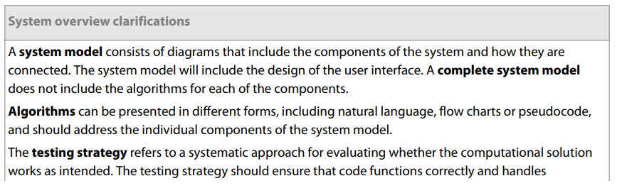
CRITERIA C – SYSTEM OVERVIEW
150 words

Slide 12
CRITERIA D – DEVELOPMENT
1000 words
Video demonstrating functionality and showing you testing the product
Justify structure of product and appropriateness
Demonstrate techniques used to develop based on algorithms from criteria C (loops, data structures, libraries, other tools, etc.)
Testing must be described in the video and justified in documentation

Slide 13
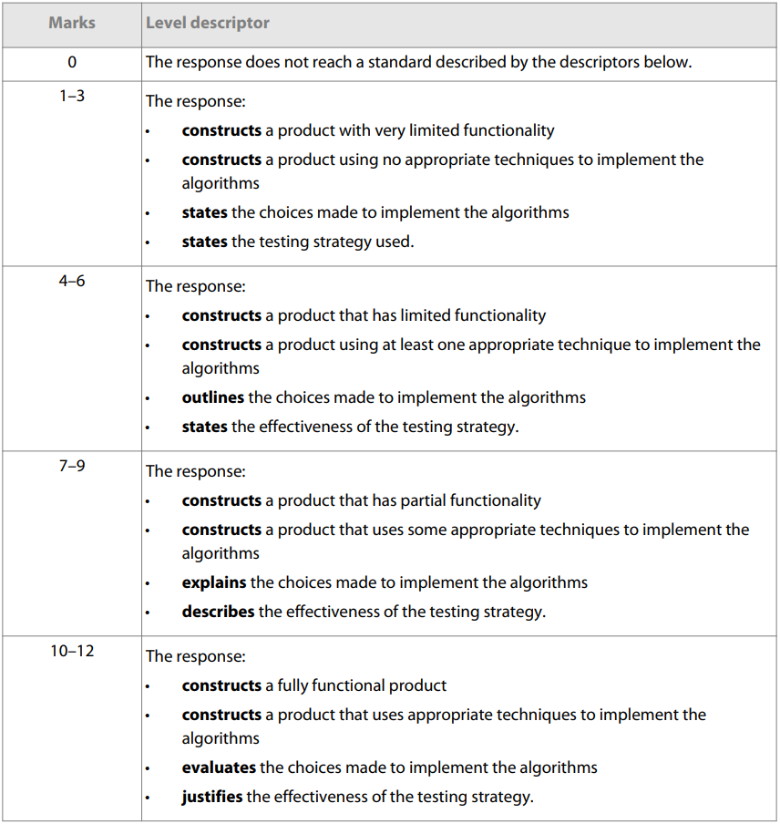
CRITERIA D – DEVELOPMENT
1000 words

Slide 14
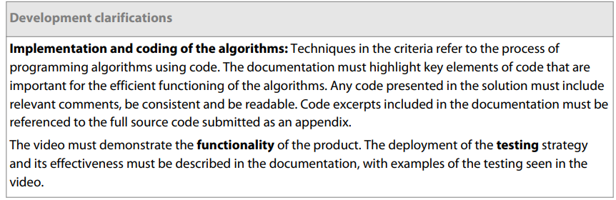
CRITERIA D – DEVELOPMENT
1000 words

Slide 15
CRITERIA E - EVALUATION
400 words
Evaluate product based on your success criteria
Justify further improvements to the product

Slide 16
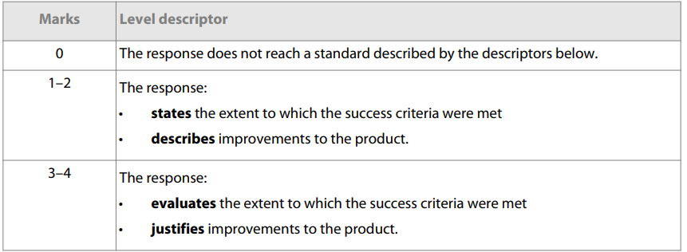
CRITERIA E - EVALUATION
400 words

Slide 17
IA EXAMPLES
Let’s look at some example IAs provided to us, and see what does well

Slide 18
YOUR TIME IS NOW
Pull up your IA Proposal Form, and let’s get those ideas churning!

